Slide 1

Mum’s Story
Done By:
Tan Wei Jun, Terris (Leader)
Muhammad Adil
Cleyshire Cheng Rui Ning
Elina Ek Pei Shan

Slide 2



Problems Faced Today
Expensive (Financial)
Time-consuming
Unprepared

Slide 3


Objective
To create a community for young parents regarding newborns
Target audience
Parents with newborns

Slide 4
Features
Forum
Online Doctor
Store
Reward system
Donation

Slide 5
Survey Questions
When you had your first child, what was your understanding of a newborn?
Do you think it would be great to have an 'online doctor' at any time of the day during working hours to answer your queries? Why or why not?
How do you feel about making trips to purchase your baby's necessities?
Would it be better to make a quick payment rather than sitting through an appointment just to purchase the product? Why or why not?
What factors do you consider when you are taking your child to the clinic? (eg. cost, time ,etc.)

Slide 6
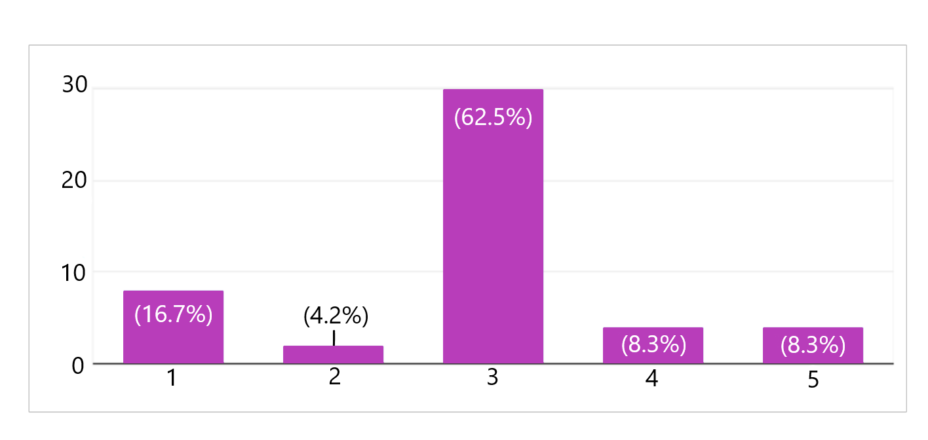
Survey Questions
When you had your first child, what was your understanding of a newborn?
(Unsure)
(Sure)

Slide 7
Survey Questions
Do you think it would be great to have an 'online doctor' at any time of the day during working hours to answer your queries? Why or why not?
67% said Yes because it is convenient and saves time.
Eg. Working days, No Travelling, Peak hours for clinics
33% said No because it may be unreliable and unused.
Eg. Unaware it exist, How-to-use, Uncertain of the Online Doctor

Slide 8
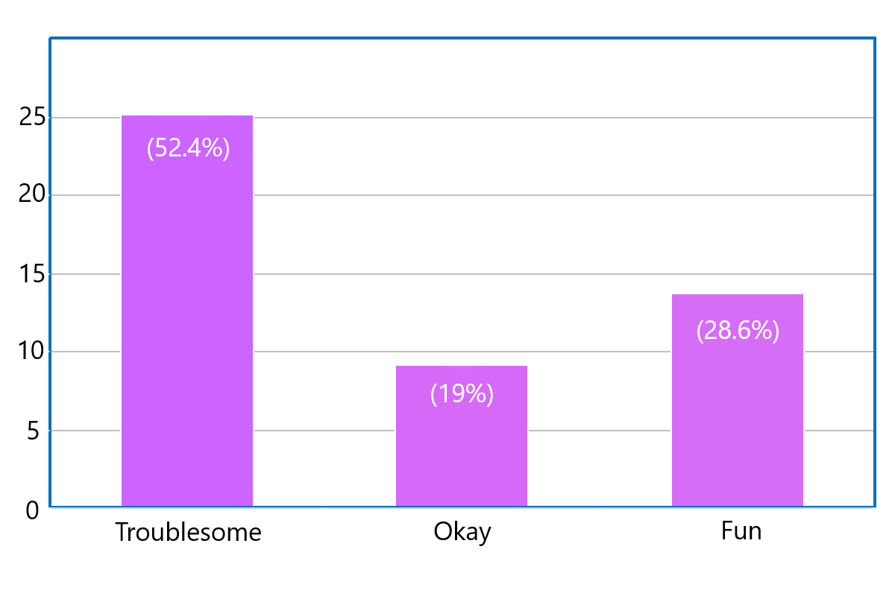
Survey Questions
How do you feel about making trips to purchase your baby's necessities?
Key Points:
25 Troublesome (52.4%)
14 Fun (28.6%)

Slide 9
Survey Questions
Would it be better to make a quick payment rather than sitting through an appointment just to purchase the product? Why or why not?
63.7% said Yes because it is convenient and saves time.
Eg. Long waiting time, Peak hours for clinics
36.3% said No because it is be better to consult the doctor.
Eg. Additional information, Important details

Slide 10
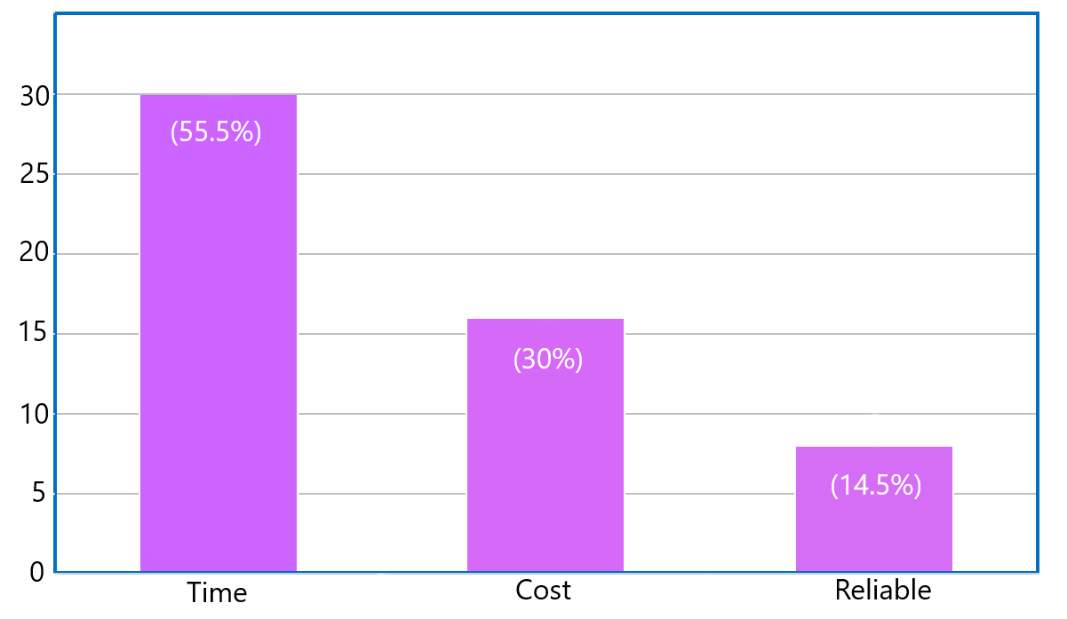
Survey Questions
What factors do you consider when you are taking your child to the clinic? (eg. cost, time ,etc.)
Multiple Answers were accepted:
30 Time (55.5%)
16 Cost (30%)
8 Reliability (14.5%)

Slide 11

Redefine Challenge
How might we provide young parents with a more convenient and efficient platform to communicate and help each other regarding newborns?

Slide 12
Solution
A Business-to-Consumer(B2C) Website that provides:
A forum that allows parents or young parents to seek help or help others when they face a problem with their new born online
24/7 online doctor that will be there for parents to consult when they face a small problem in the middle of the night and they cannot find a neighbourhood clinic near their area
An online shop for parents to purchase basic necessities for their baby after getting recommendations from other users or the online doctor
Web Catalogue Model and Advertising-Supported Model

Slide 13
Benefits To Customers
How does it benefit our customers:
A forum can help answer any simple enquiries and create a friendly community
24/7 online doctor can help solve more challenging problems with the convenience of being at home
The online store provides a more convenient shopping experience
Rewarding system to redeem products and services

Slide 14
SWOT Analysis
Strengths
Sell directly to consumers
Keep costs below competitors’ costs
24/7, Online Service
Always relevant
Weakness
Only target online users
Misuse of the platform
Rely on the community
Opportunities
Creates a community
Consumer desires to spend less time making physical trips
Consumer know what they want to buy
Solve consumers’ problems efficiently
Threats
Competitors have stronger brand names
Competitors have more experience
Lack of service differentiation

Slide 15

Competitors
Kiasu Parents
Singapore Motherhood
Mummy SG
Young Parents

Slide 16

Source of Profit
Selling products
Commission-based
Donations (in the long-run)
Advertisement

Slide 17
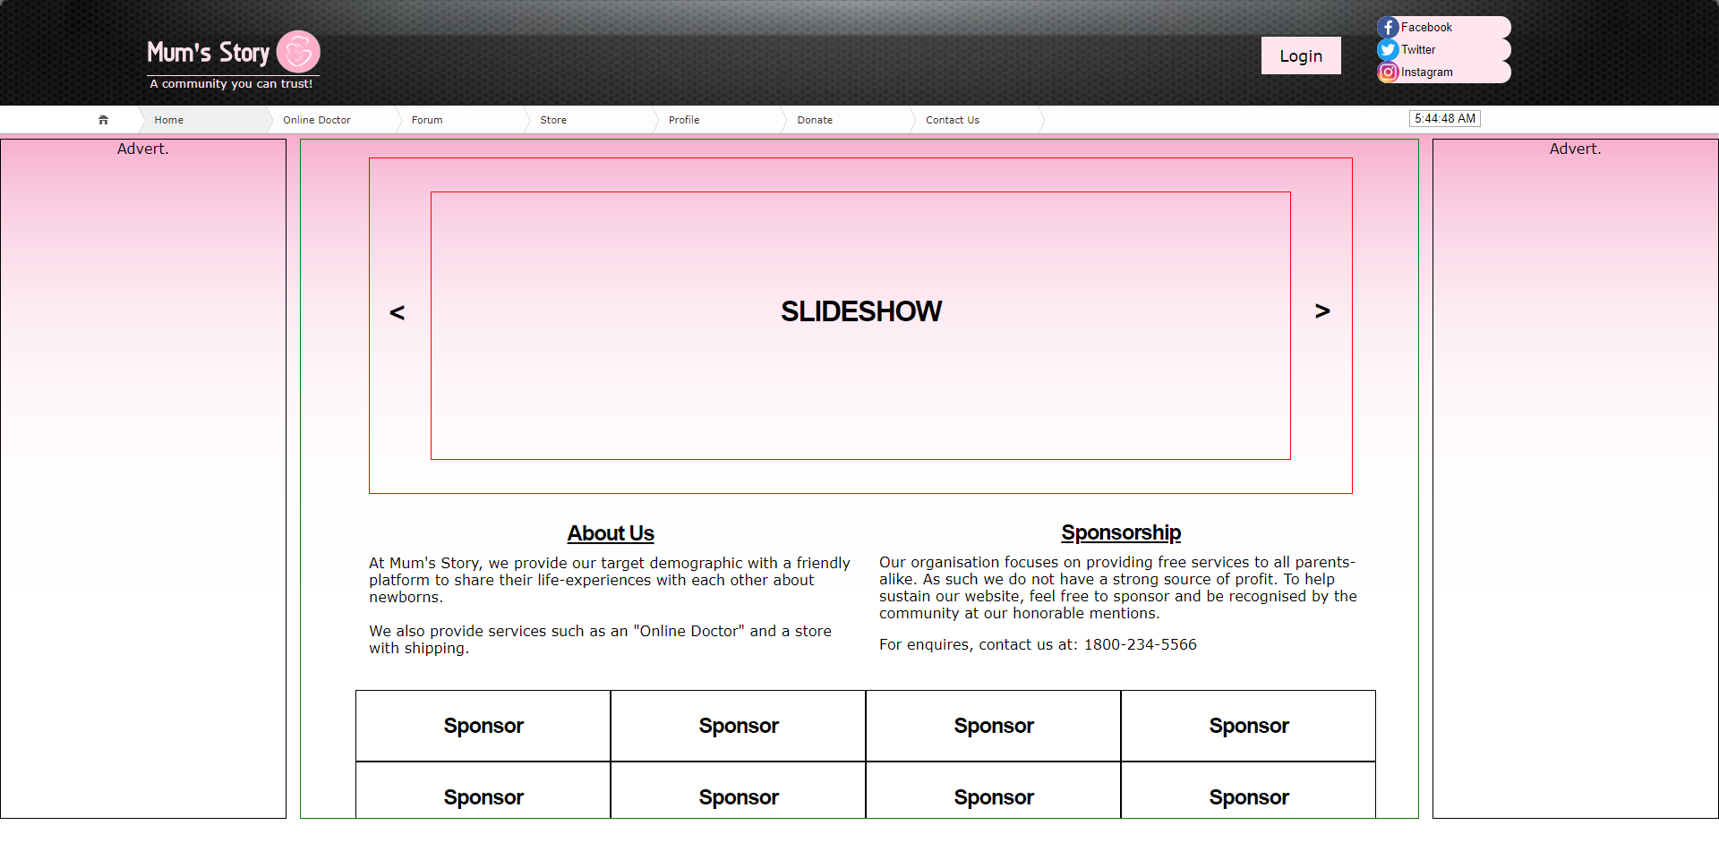
Sample
Wireframe
(Actual Size)

Slide 18
Q&A

Slide 19
Thank You!

